Slide 1
Sugar pine
Demographic status, trajectory, and stressors
Notes:
Premise of this work is an NPS funded project focused on conservation of sugar pine
Also going to be a dissertation chapter, hopefully a journal article & conference presentation

Slide 2
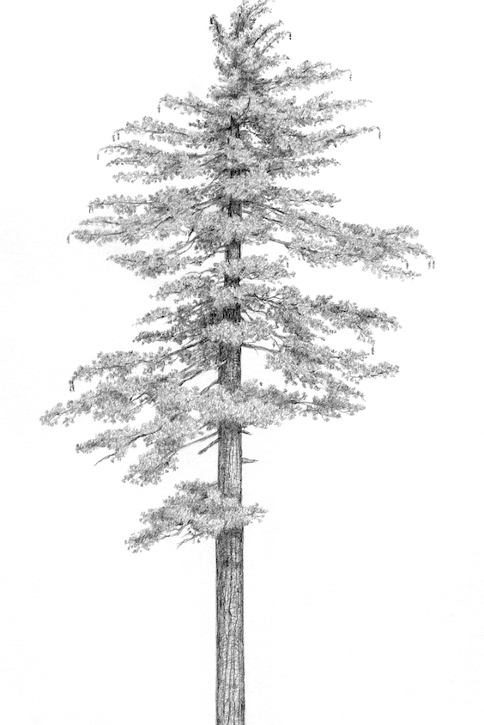
Pinus lambertiana (sugar pine)
5-25% of basal area in the mixed conifer forest type in CA and OR
Valuable food source for wildlife
The largest member of Pinus, the “Queen of the Sierra”
Facing numerous threats
Matt Strieby

Slide 3
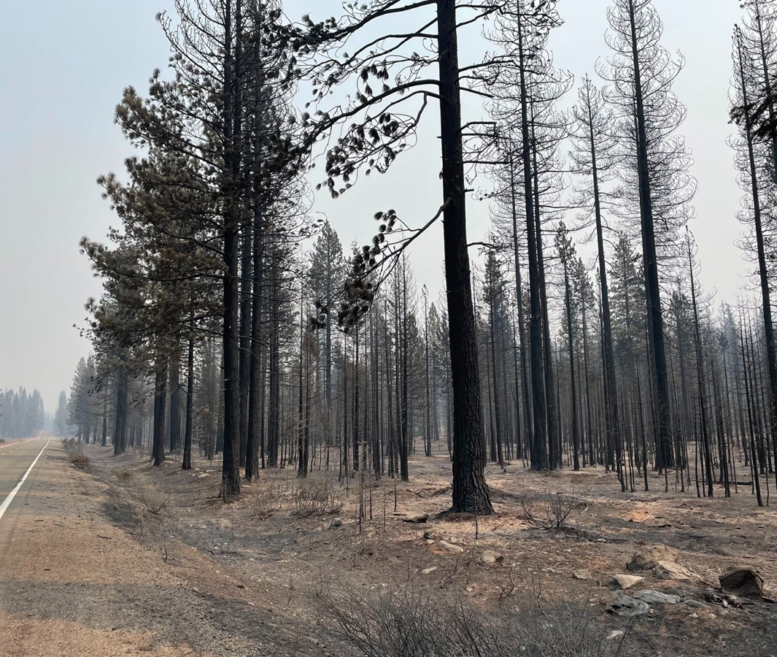
High-severity fire
Increasing HS patch size
Increasing area affected
Scott Rodd, capRadio
Notes:
Problem 1: too much HS fire
PILA is fire-adapted, but with a fire-resisting life history strategy
Fire suppression -> fuels + climate change = increases in HS fire
Increasing patch size, increasing area affected

Slide 4
Cronartium ribicola (White pine blister rust)
Dudney et al., (2020) Ecosphere
Geils et al., (2010) Forest Pathology
Notes:
Invasive fungal pathogen cronartium ribicola
Introduced to north America early 20th century, now spread across much of PILA’s range
Infection reduces vigor and can kill by girdling stems, esp small ones
Major threat an endangered relative of PILA
lots of concern from managers / policymakers

Slide 5
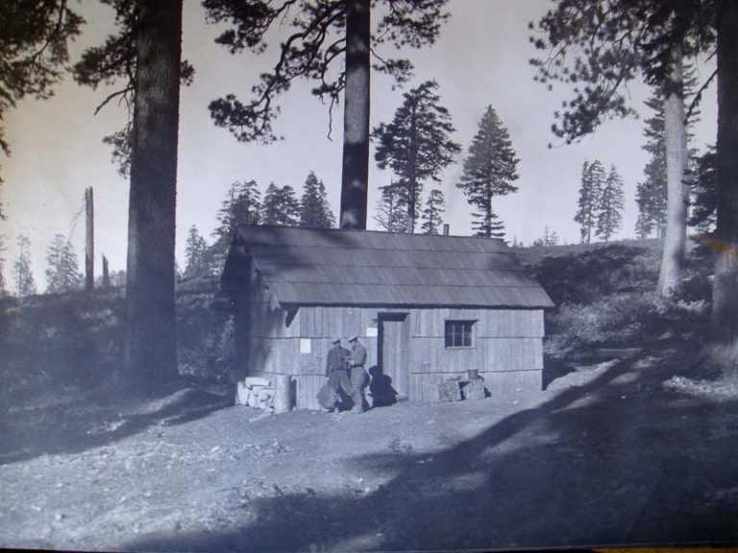
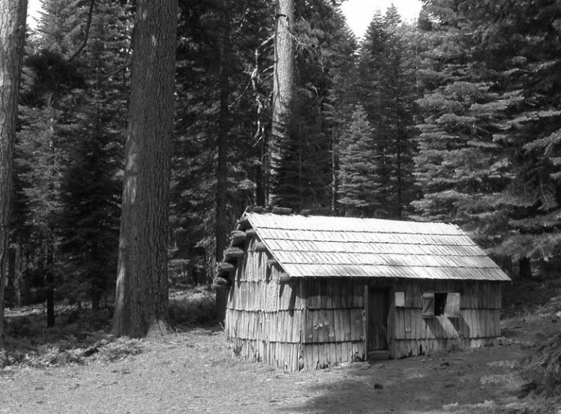
Densification
Plumas National Forest
Plumas National Forest
Notes:
Left and right: same spot, 100 years apart
On the left: early 20th century, at the start of active fire suppression on the national forests; a few big trees, open “parklike” understory
On the right: early 21st century, after 100 years of fire suppression: lots of small ingrowth trees, conditions favor shade tolerant spp like ABCO, CADE,\
Densification also linked with fire hazard problem

Slide 6
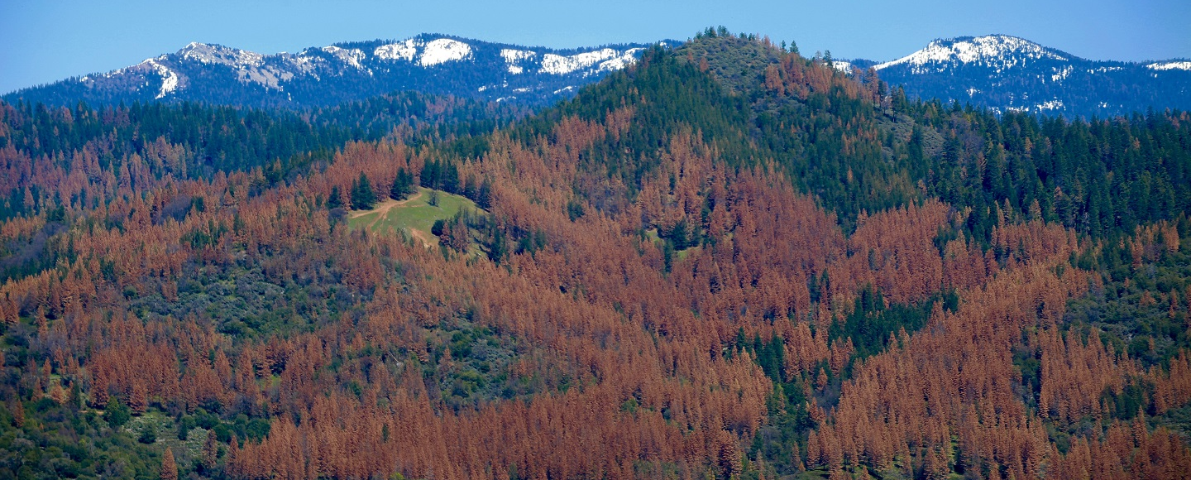
Drought and bark beetles
NASA
Notes:
In recent years, have seen historically severe droughts
As entire populations of trees get stressed simultaneously, conditions right for an epidemic outbreak of bark beetles
Bark beetles native insects, lay eggs by boring into trees & larvae eat the cambium, can kill the host tree
When beetle population is big enough to mass attack they usually target the largest / oldest tree individuals
Have seen really severe outbreaks in the wake of the 2012-2016 drought, esp. in the southern sierra

Slide 7
Questions
What is the relative importance of the various stressors affecting sugar pine?
What is the current status and trajectory of the ensemble of sugar pine populations across its range?

Slide 8
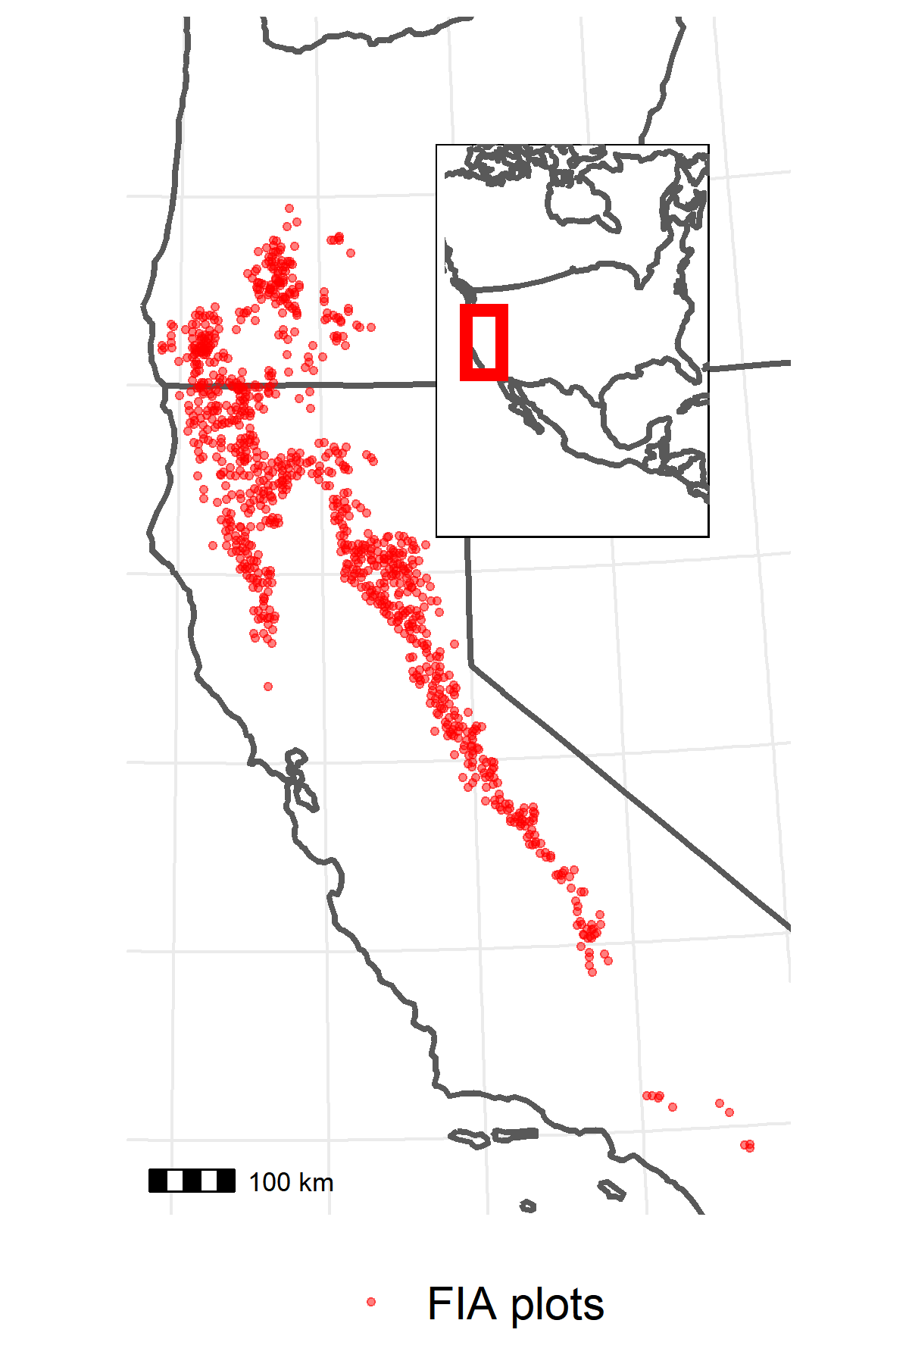
Data
US Forest Service Forest Inventory and Analysis (FIA) plot network
956 plots within mapped PILA range and with PILA present
Included harvested plots
1/10th of plots visited every year since 2001
~10 years between visits, 2 visits per plot
On each plot:
Inventory of trees: Species, live/dead, diameter at breast height (DBH), evidence of damage/disease (e.g., WPBR)
Tally of seedlings by species
Presence of disturbances (e.g., fire)
TerraClimate dataset to estimate mean growing season climatic water deficit (CWD) at each plot location in each year

Slide 9
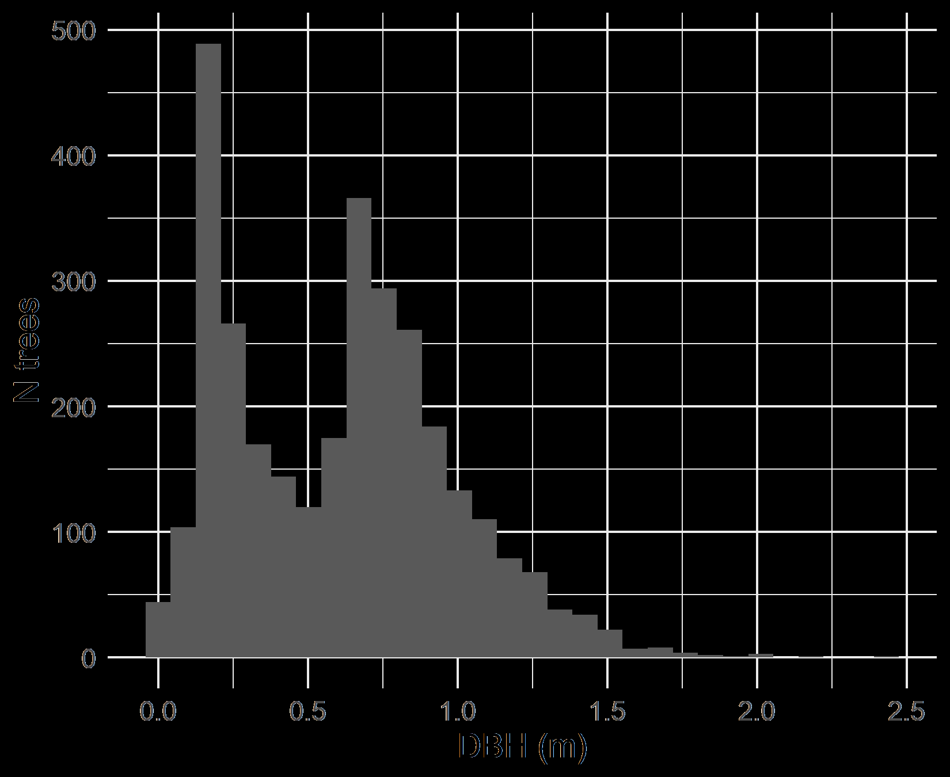
Data II
Explanatory variables
Size
DBH at initial census
Fire
T/F; between initial and remeasurement
WPBR
T/F; present at initial
Density
Subplot basal area at initial
Drought
90th percentile CWD departure between initial and remeasurement
Site dryness
Mean CWD from 2000-2020
All 2-way interactions with size

Slide 10
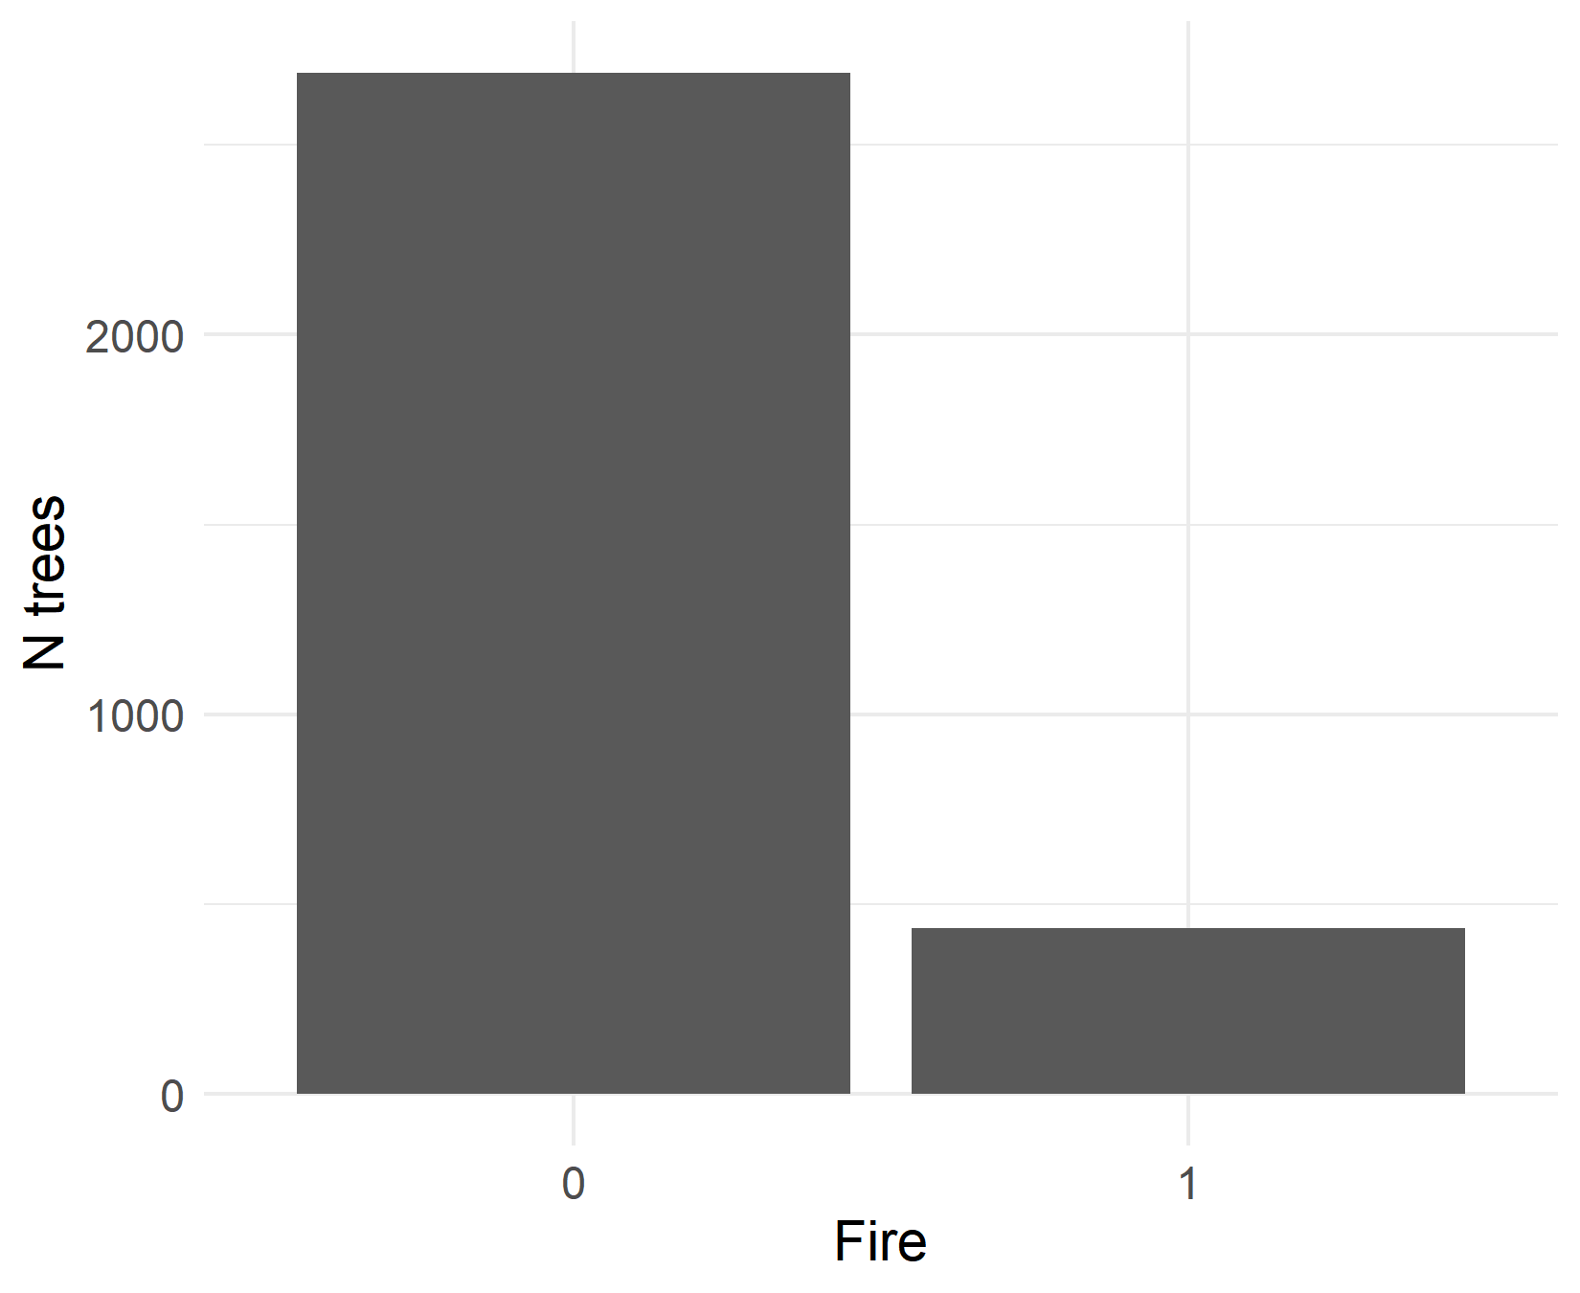
Data II
Explanatory variables
Size
DBH at initial census
Fire
T/F; between initial and remeasurement
WPBR
T/F; present at initial
Density
Subplot basal area at initial
Drought
90th percentile CWD departure between initial and remeasurement
Site dryness
Mean CWD from 2000-2020
All 2-way interactions with size

Slide 11
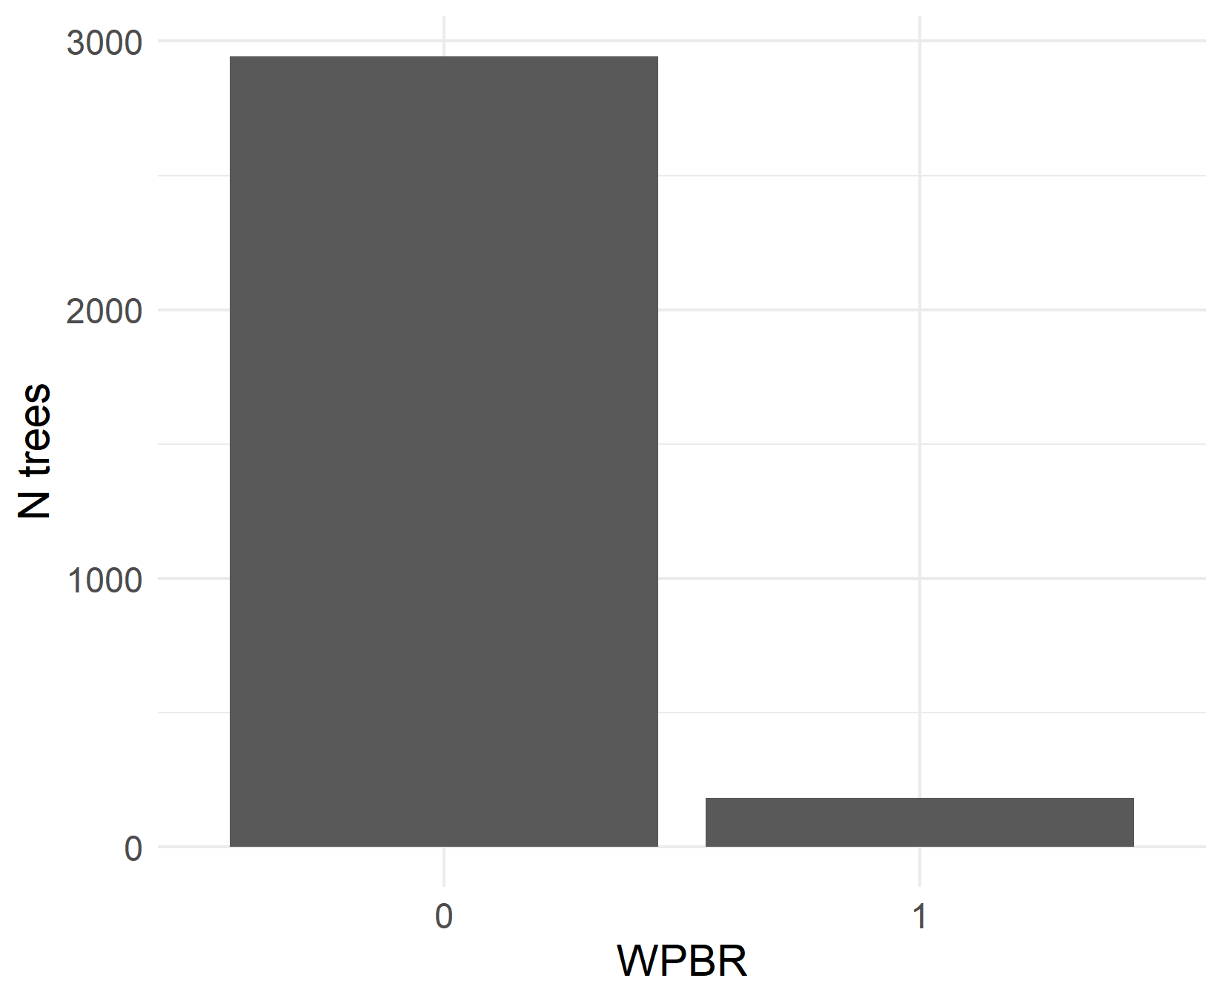
Data II
Explanatory variables
Size
DBH at initial census
Fire
T/F; between initial and remeasurement
WPBR
T/F; present at initial
Density
Subplot basal area at initial
Drought
90th percentile CWD departure between initial and remeasurement
Site dryness
Mean CWD from 2000-2020
All 2-way interactions with size

Slide 12
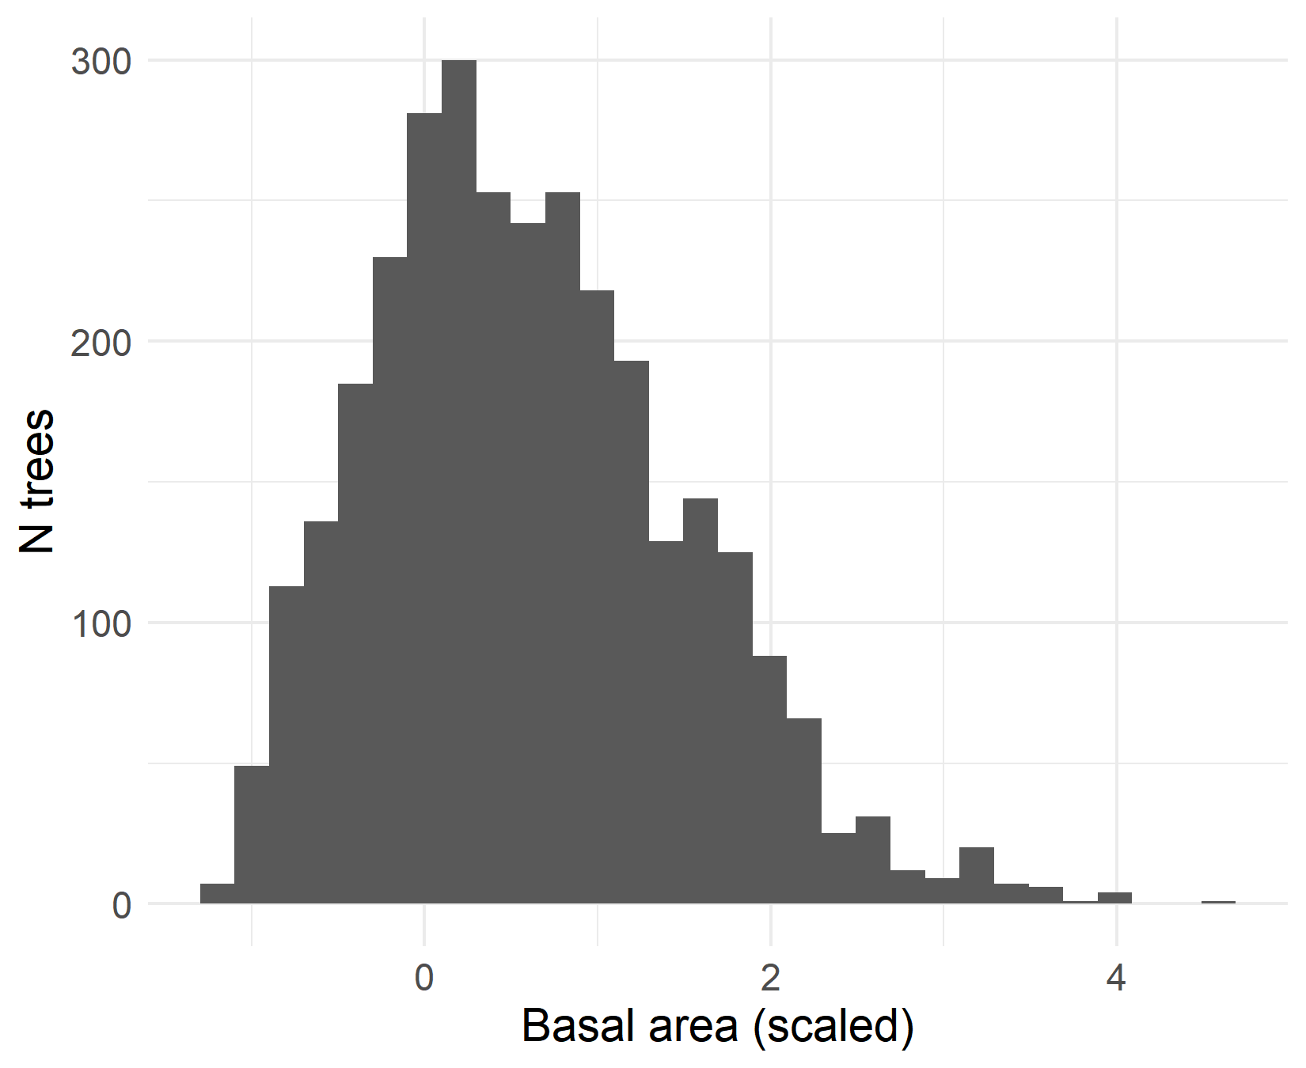
Data II
Explanatory variables
Size
DBH at initial census
Fire
T/F; between initial and remeasurement
WPBR
T/F; present at initial
Density
Subplot basal area at initial
Drought
90th percentile CWD departure between initial and remeasurement
Site dryness
Mean CWD from 2000-2020
All 2-way interactions with size

Slide 13
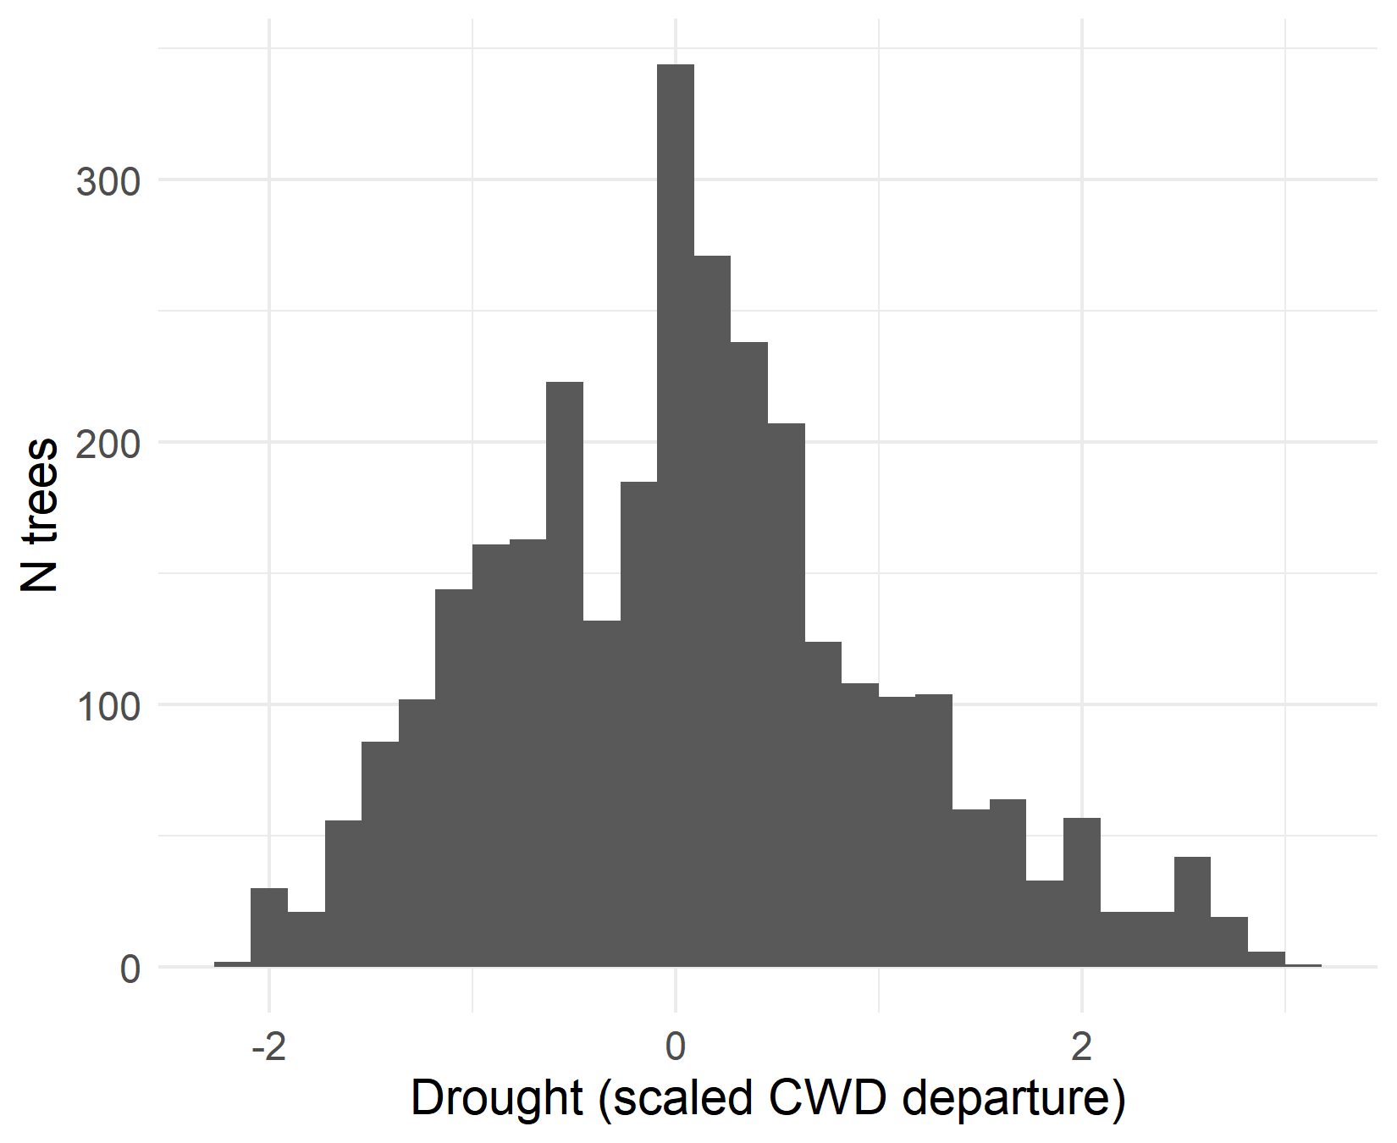
Data II
Explanatory variables
Size
DBH at initial census
Fire
T/F; between initial and remeasurement
WPBR
T/F; present at initial
Density
Subplot basal area at initial
Drought
90th percentile CWD departure between initial and remeasurement
Site dryness
Mean CWD from 2000-2020
All 2-way interactions with size

Slide 14
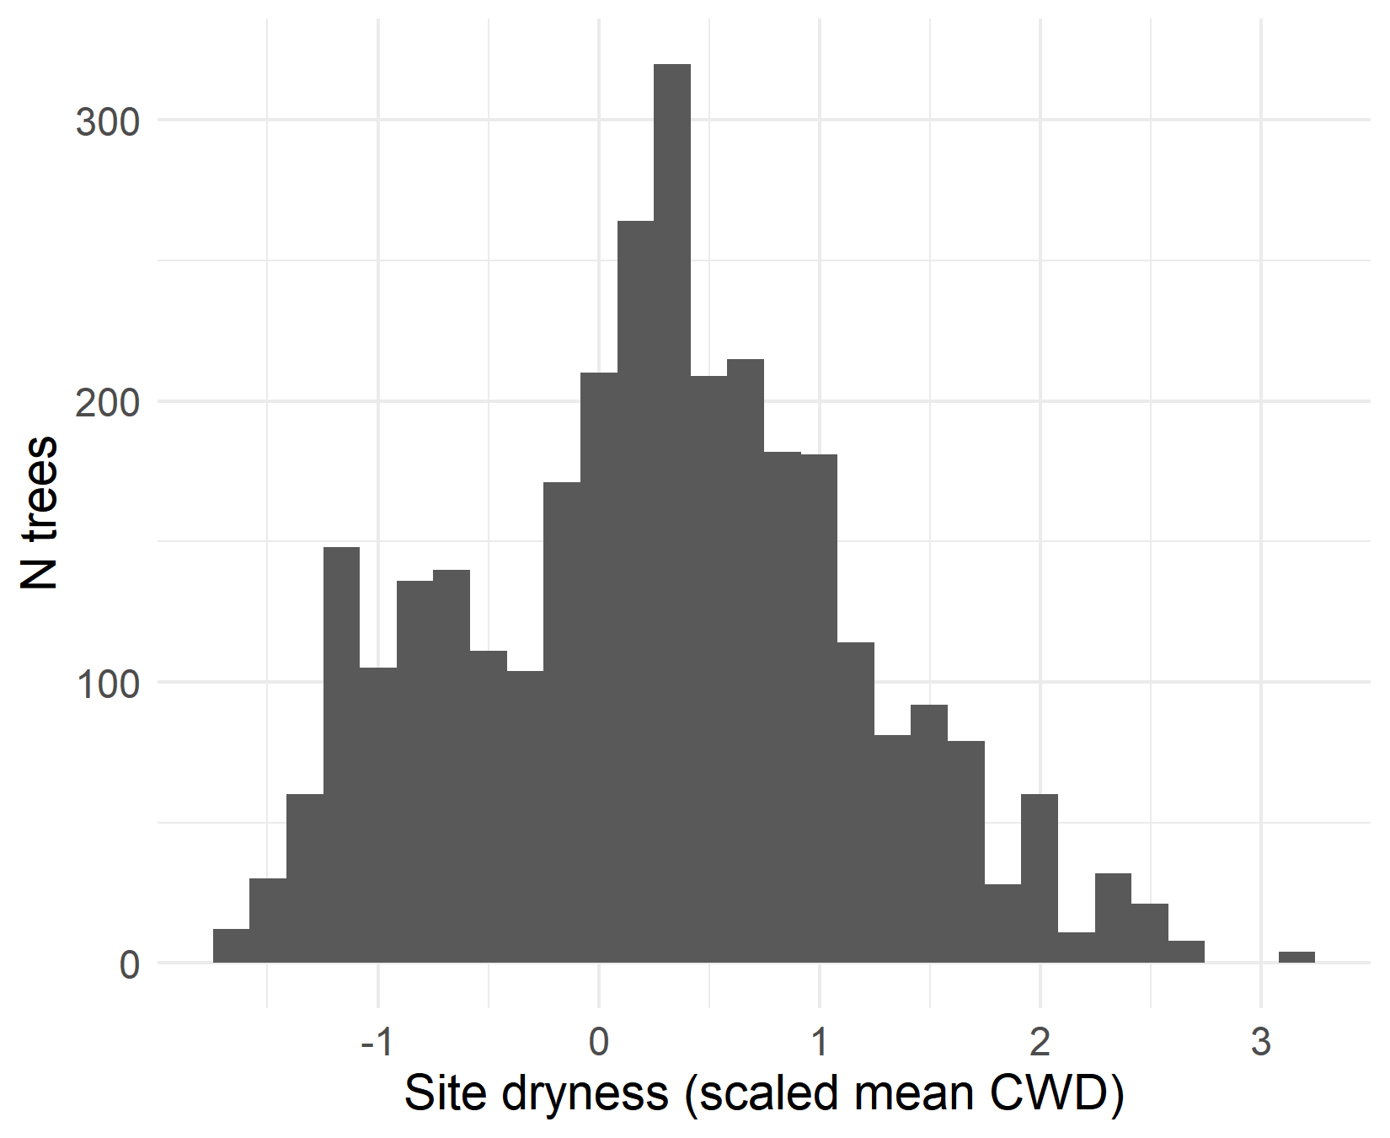
Data II
Explanatory variables
Size
DBH at initial census
Fire
T/F; between initial and remeasurement
WPBR
T/F; present at initial
Density
Subplot basal area at initial
Drought
90th percentile CWD departure between initial and remeasurement
Site dryness
Mean CWD from 2000-2020
All 2-way interactions with size

Slide 15
Data II
Explanatory variables
Size
DBH at initial census
Fire
T/F; between initial and remeasurement
WPBR
T/F; present at initial
Density
Subplot basal area at initial
Drought
90th percentile CWD departure between initial and remeasurement
Site dryness
Mean CWD from 2000-2020
All 2-way interactions with size

Slide 16
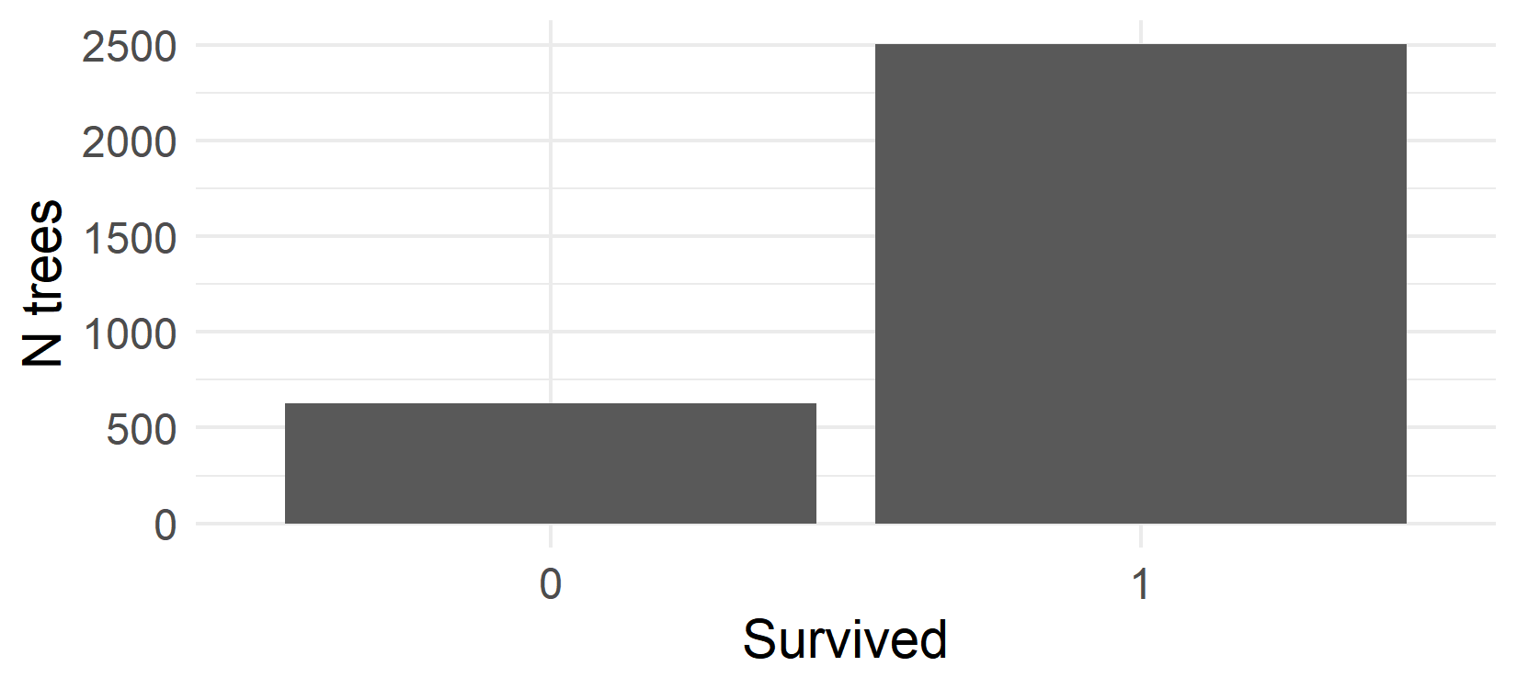
Data II
Explanatory variables
Size
DBH at initial census
Fire
T/F; between initial and remeasurement
WPBR
T/F; present at initial
Density
Subplot basal area at initial
Drought
90th percentile CWD departure between initial and remeasurement
Site dryness
Mean CWD from 2000-2020
All 2-way interactions with size
Response variables
Survival
T/F; alive at remeasurement
Growth
Size at remeasurement
N untagged trees at remeasurement

Slide 17
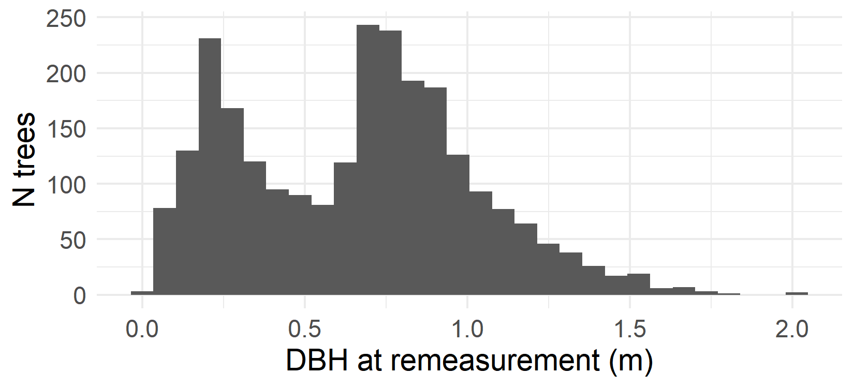
Data II
Explanatory variables
Size
DBH at initial census
Fire
T/F; between initial and remeasurement
WPBR
T/F; present at initial
Density
Subplot basal area at initial
Drought
90th percentile CWD departure between initial and remeasurement
Site dryness
Mean CWD from 2000-2020
All 2-way interactions with size
Response variables
Survival
T/F; alive at remeasurement
“Growth”
Size at remeasurement
N untagged trees at remeasurement

Slide 18
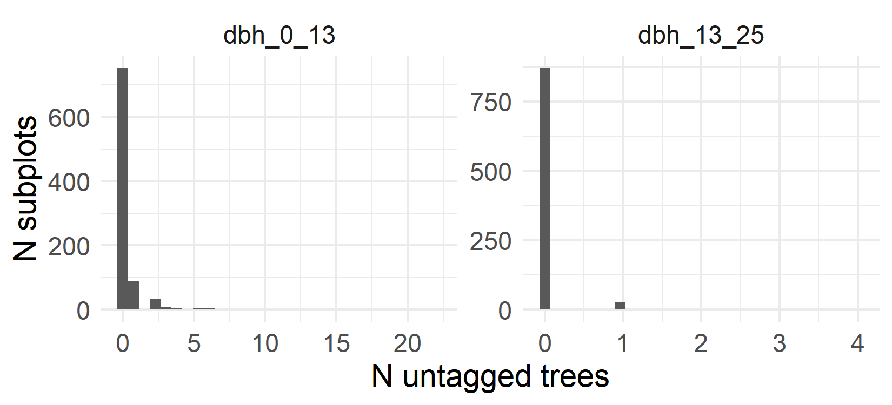
Data II
Explanatory variables
Size
DBH at initial census
Fire
T/F; between initial and remeasurement
WPBR
T/F; present at initial
Density
Subplot basal area at initial
Drought
90th percentile CWD departure between initial and remeasurement
Site dryness
Mean CWD from 2000-2020
All 2-way interactions with size
Response variables
Survival
T/F; alive at remeasurement
Growth
Size at remeasurement
N untagged trees at remeasurement

Slide 19
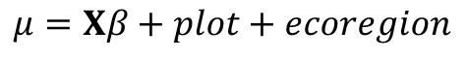
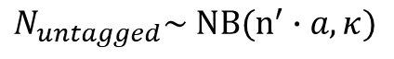
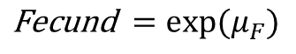
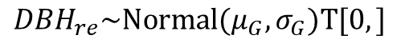
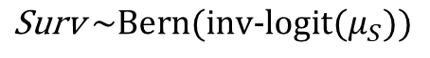
Analysis
Explanatory variables
Vital rate functions
Survival
Integral projection model
Fire
WPBR
Basal area
Drought
Site dryness
Growth
Fecundity
Size-class transition matrix
Asymptotic population growth rate
Interactions with DBH
DBH
$$\text{S}\text{urv} \sim \text{Bern}\text{(}\text{inv}\text{−}\text{logit}(μ_{S}))$$
$${DBH}_{re}\sim \text{Normal}\text{(}μ_{G}, σ_{G})T[0,]$$
$$\text{F}\text{ecund} =exp⁡(μ_{F})$$
$$μ=Xβ+plot+ecoregion$$
$$N_{untagged}\sim \text{N}B(n^{′}∙a, κ)$$
Based on Shriver et al. (2021)
Notes:
Analysis closely follows that of shriver et al, which allows demographic analysis of growth, mortality, and fecundity with the wrinkle that the smallest trees are just tallied, not tracked individually
Generalized linear models with those variables as explanatory variables for a linear predictor term
3 models
Survival: Bernoulli response with a logit link
Growth: truncated-normal response
Fecundity: not observed directly, estimated using an integral projection model
# of untagged trees is both new recruits (interested) + surviving individuals that were there at the initial census (not interested)
Use information from the survival and growth models, plus the number of untagged individuals at the initial census, to estimate the survival and growth of the small trees which were present at the initial census, and thus the # of new recruits which have appeared among untagged trees at the second census
Using these vital rate functions to construct an integral projection model (describing how the size distribution of the population will change over time)
Important summary statistic is lambda, the asymptotic population growth rate (define)

Slide 20
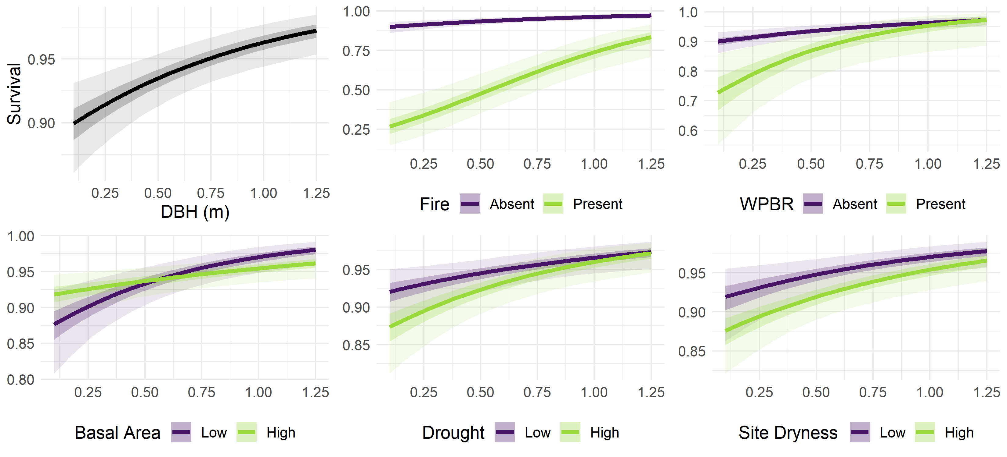
Results: Survival
Notes:
Figure: effects plot, showing the predicted response (y axis) given some assumed explanatory variables (x axis and color);
Each panel looks at a different explanatory variable: size a stressor, and their interaction
The size varies along the x axis, and the focal stressor is either present/absent or high/low (color); all other explanatory variables are held at 0 (false or the mean)

Slide 21
Results: Survival
Notes:
E.g. size graph in the top left shows predicted survival for hypothetical trees with dbh 0-1.25, assuming no FIRE or WPBR, and mean BA, Drought, and Dryness, same as the purple line in the fire graph top middle

Slide 22
Results: Survival
Notes:
Green line in the fire graph (top middle) shows predicted survival for a range of sizes, assuming fire occurred on the plot, purple line assumes predicted survival assuming no fire

Slide 23
Results: Survival
Notes:
Size: + main
Fire: -- main, + interaction
WPBR: -- main, 0 interaction
BA: + main, - interaction
Drought: - main, 0 interaction
Dryness: 0 main, 0 interaction

Slide 24
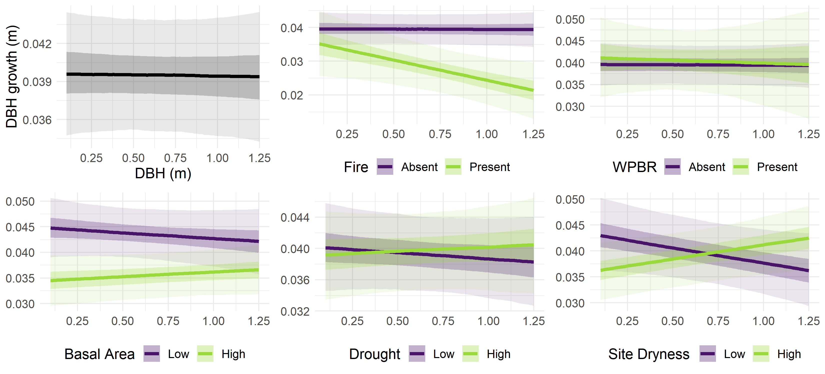
Results: Growth
Notes:
Similar effects plots, now with growth (difference between size0 and sizeT) on the y axis
Intercept: 0.035-0.044
Fire: 0 main, - interaction
WPBR: 0 main, 0 interaction
BA: - main, 0 interaction
Drought: 0 main, 0 interaction
Dryness: - main, + interaction

Slide 25
Results: Growth
Notes:
Intercept: 0.035-0.044
Fire: 0 main, - interaction
WPBR: 0 main, 0 interaction
BA: - main, 0 interaction
Drought: 0 main, 0 interaction
Dryness: - main, + interaction

Slide 26
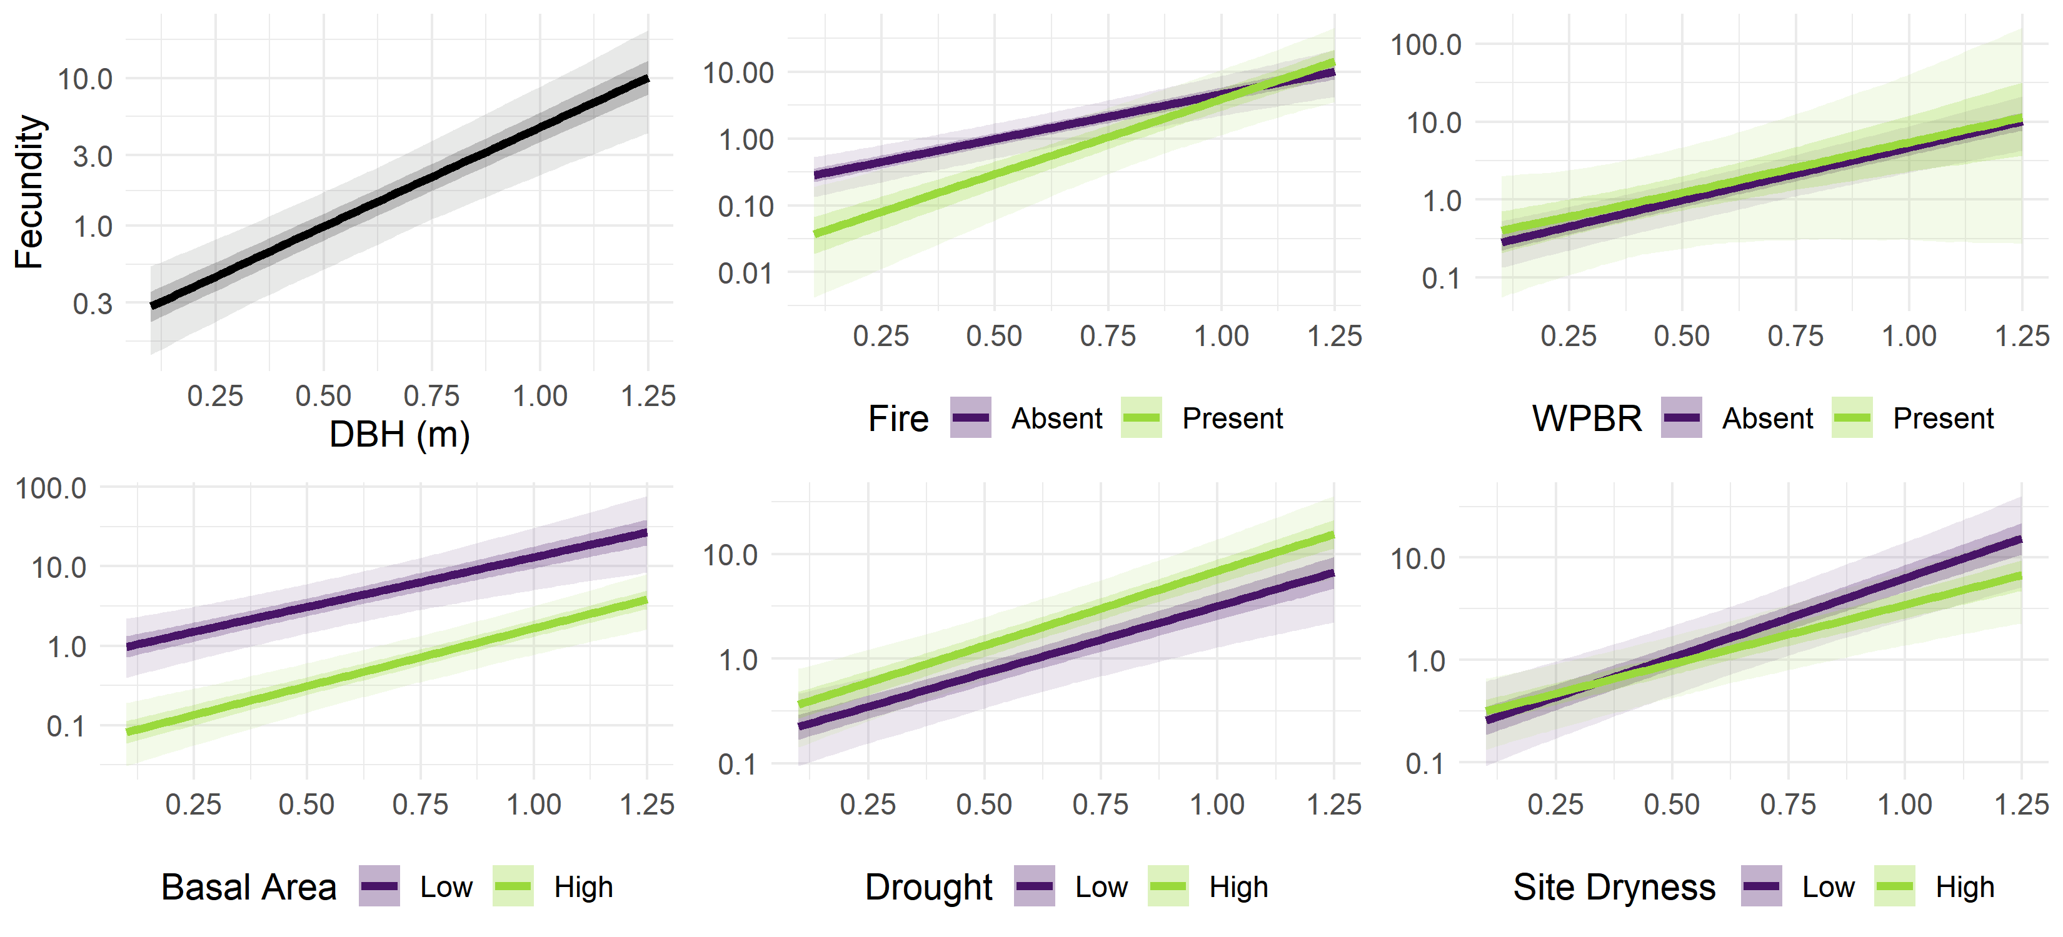
Results: Fecundity
Notes:
Size: + main
Fire: - main, + interaction
WPBR: 0 main, 0 interaction
BA: - main, 0 interaction
Drought: 0 main, 0 interaction
Dryness: 0 main, 0 interaction

Slide 27
Results: Fecundity
Notes:
Size: + main
Fire: - main, + interaction
WPBR: 0 main, 0 interaction
BA: - main, 0 interaction
Drought: 0 main, 0 interaction
Dryness: 0 main, 0 interaction

Slide 28
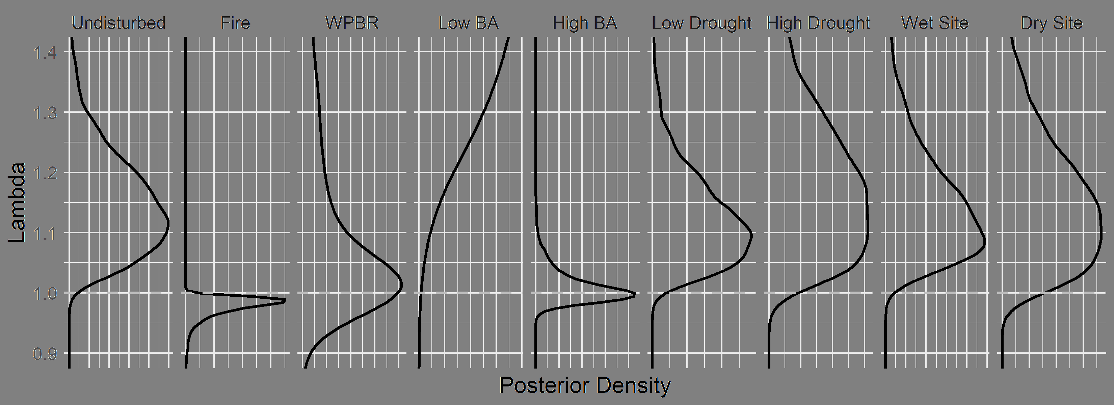
Results: Stressor effects on asymptotic population growth rate
Notes:
Figure: vital rates synthesized into an IPM, extracting the posterior asymptotic pop growth rate for each scenario
X axis is posterior probability density, y axis is lambda value (>1 is population increase, 1 is constant, <1 is population decline), panels show different stressor conditions

Slide 29
Results: Stressor effects on asymptotic population growth rate
Notes:
Fire: 90% CI for lambda is lower than 1; clear that fire negatively affects the trajectory of population growth
Low BA: 90% CI for lambda is way above 1: low basal area really boosts the trajectory of population growth

Slide 30
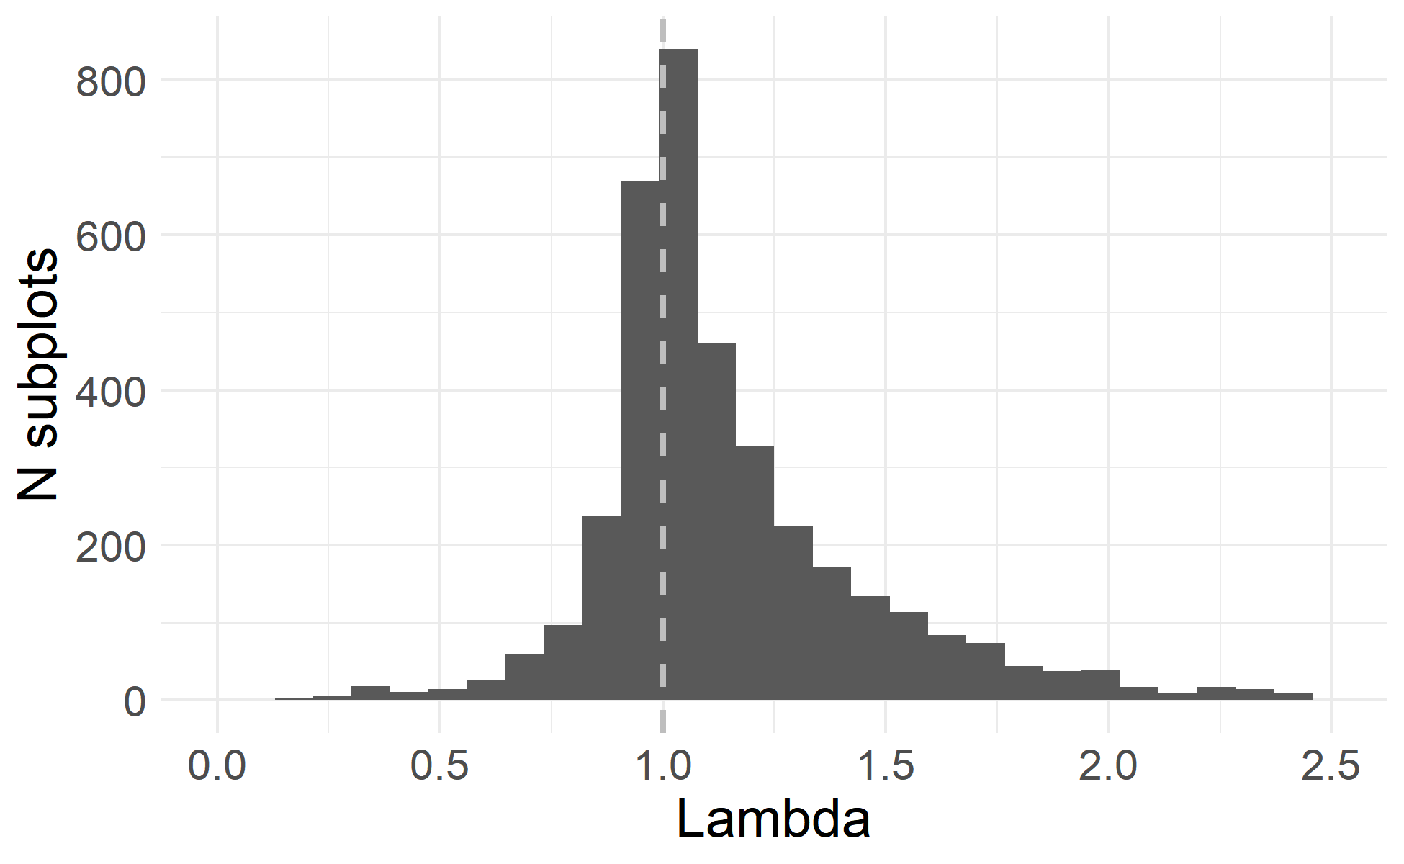
Results: Asymptotic population growth rate across sampled subplots
IQR 0.98 to 1.29
Median 1.07
Lambda < 1 on 34.6% of subplots
Assumes conditions held constant over time
Notes:
Figure: histogram of the predicted lambda (using posterior median parameter values) across the range of actual subplots where PILA was present
On the median subplot, population is predicted to slowly increase assuming conditions are held constant
On a third of subplots, population is predicted to decline assuming conditions are held constant
“Constant conditions” is not a realistic assumption (e.g. burned subplots probably wont get reburned every 10 years, unburned subplots may get burned), so care needed to interpret this figure

Slide 31
Management implications
Insights:
Fire and density are key stressors
Demographic value of large/old individuals
Responses:
Fuel treatments
Density reduction

